Slide 1
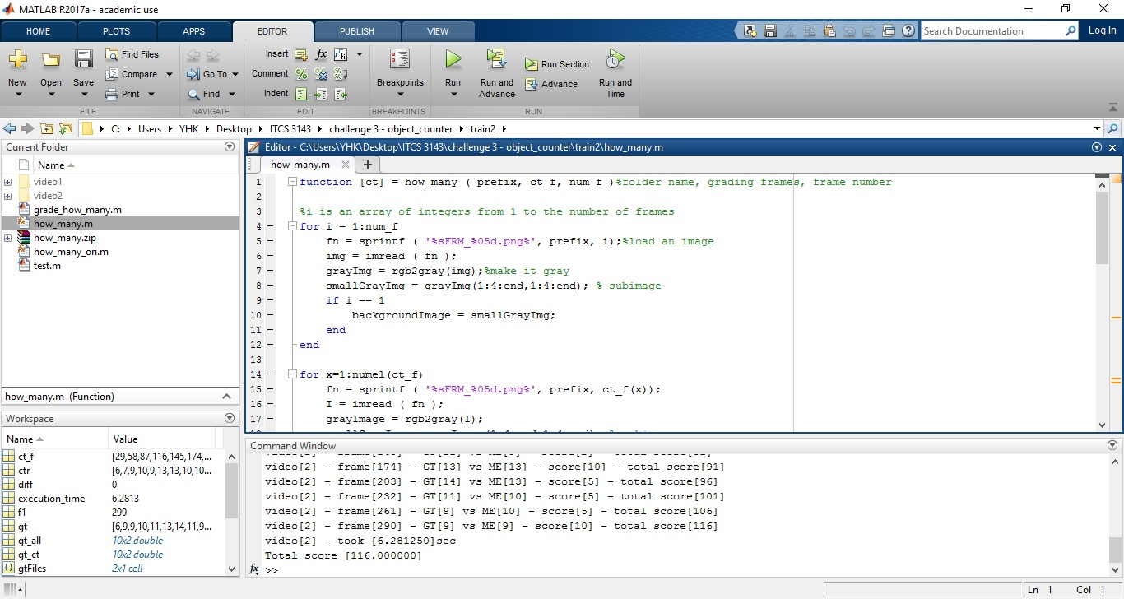

YinHang Kwok
ITCS 3134 Spring 2017
Digital Image Processing
Challenge 3
Count Object

Slide 2
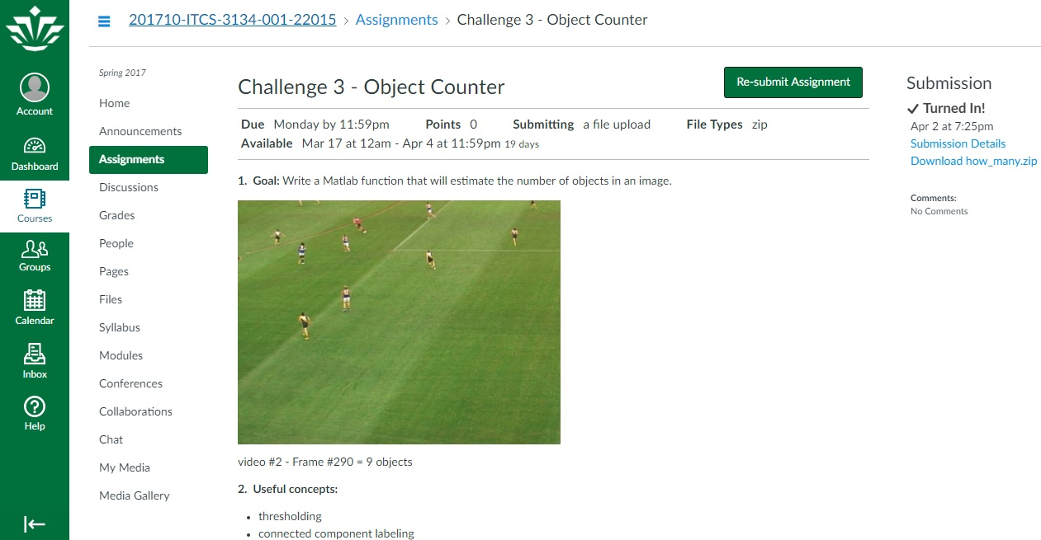

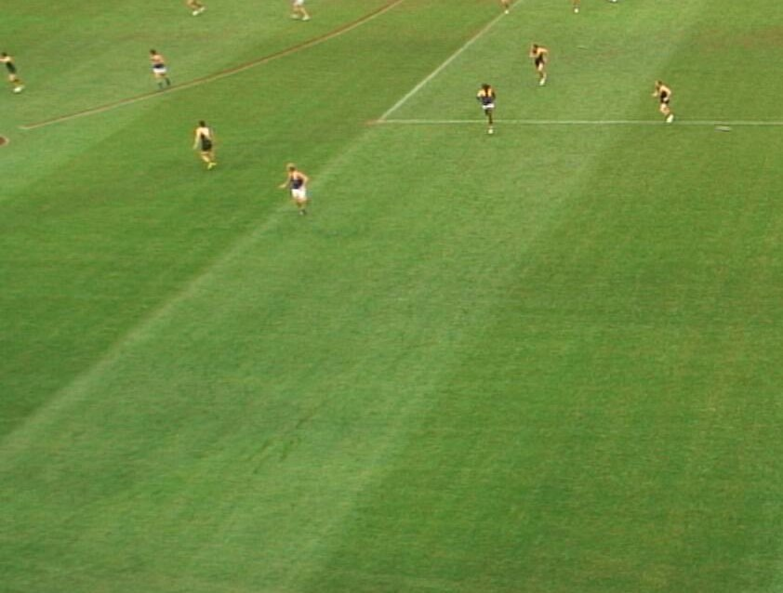
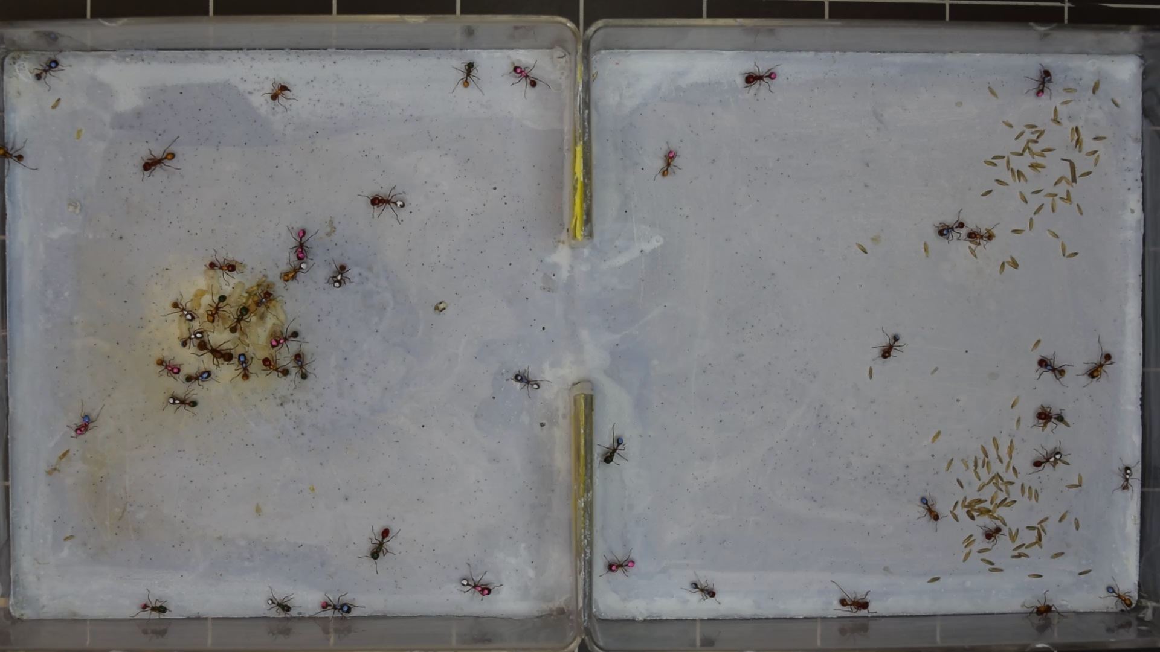
Challenge Three
Goal
Find the number of objects in an image

Slide 3

How To Solve This Problem?
Method
Background Subtraction
1. First Image To Be The Background
2. Other Image – background Image
3. Find the group of pixels remain

Slide 4

Function & Knowledge
1. Convert RGB image to grayscale
2. Filter - mean, median, Gaussian
3. Point Transformation - LCS
4. image threshold - Otsu's method
5. Morphology - Dilate & Erode
6. Boundary Extraction - SRR
7. Connected Component Labeling

Slide 5


Work Flow
Linear Contrast Stretching
Original approach
input
Gray
Filter
Subtraction
dilate
erosion
CCL
Small region removal
Problem :
image too big for filter, subtraction, LCS…etc.
Time too long
high CPU usage

Slide 6
Work Flow
Speed up approach
Subtraction
Small region removal
input
Gray
erosion
Filter
dilate
CCL
Sub image
Linear Contrast Stretching
(1:4:end,1:4:end)
Speed UP!

Slide 7

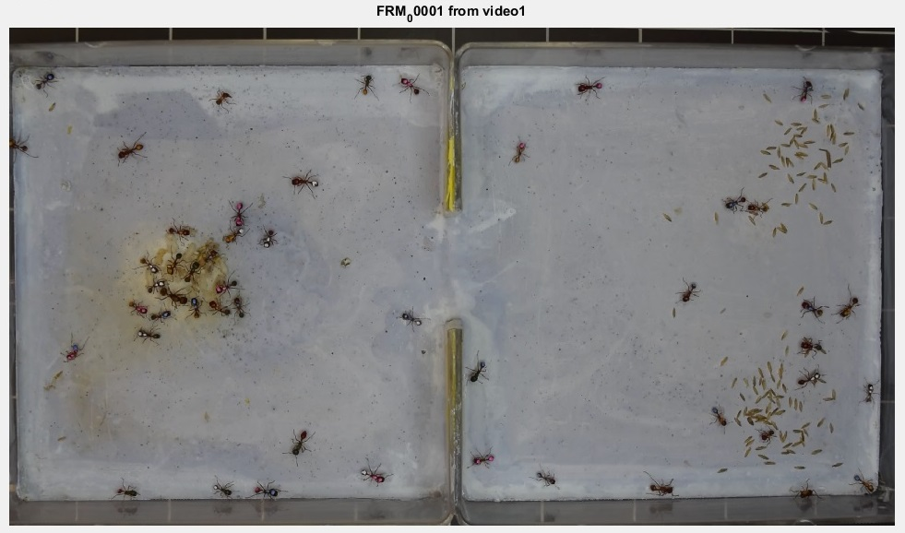
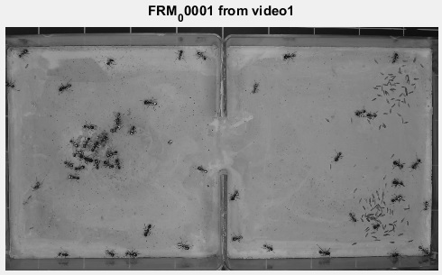
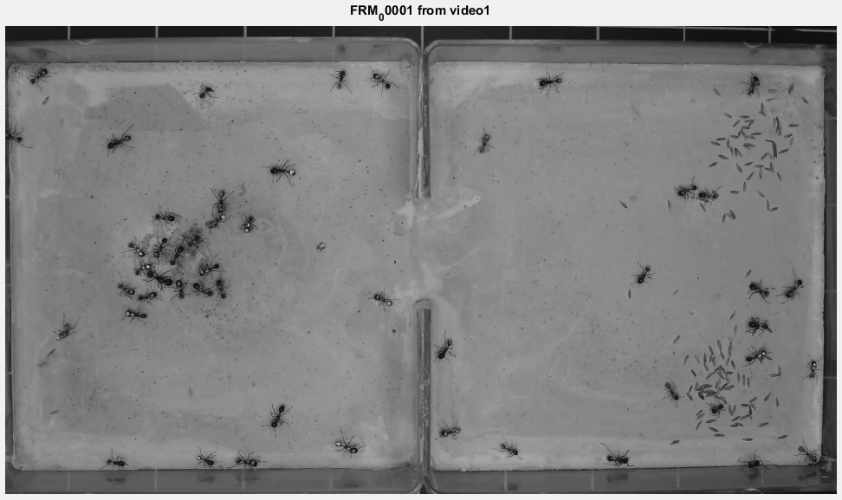
Create Background image
2. Gray image – rgb2gray
1. Input image
3. Sub image – (1:4:end,1:4:end)

Slide 8

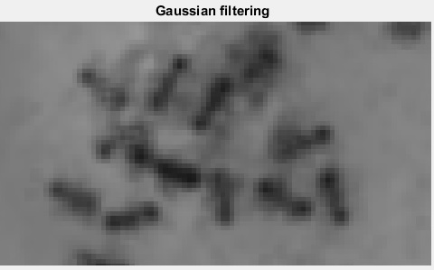
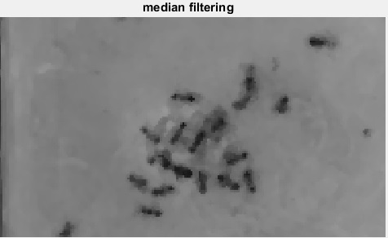
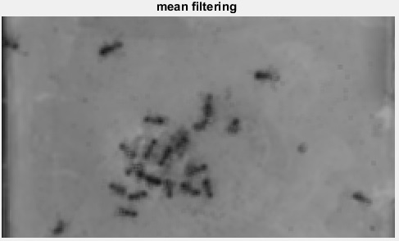
Choose Filter
Tried sig = 2,3,4
But median filter look better
Filtered unwanted pixels, look better
Too Hard to do segmentation

Slide 9

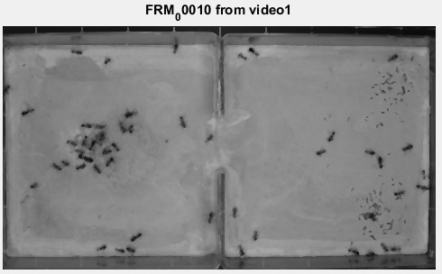

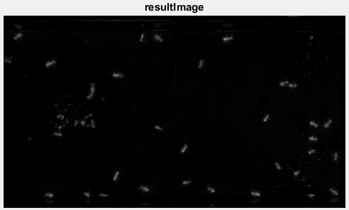
Background Subtraction
Background Image
Frame 0010
Subtracted image

Slide 10

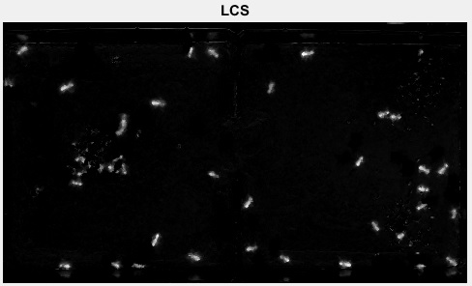
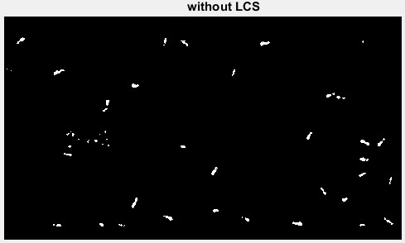
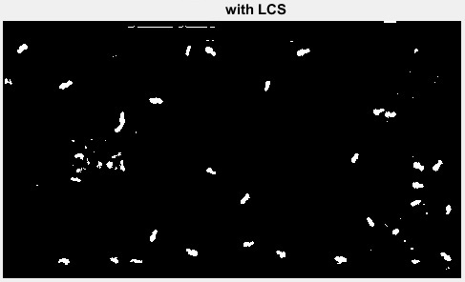
Get better Binary image?
Using LCS
Image from subtraction

Slide 11

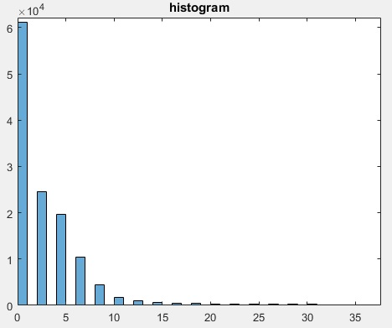

Get better Binary image?
Thresholding
T value for thresholding
Pixel Count
Intensity

Slide 12

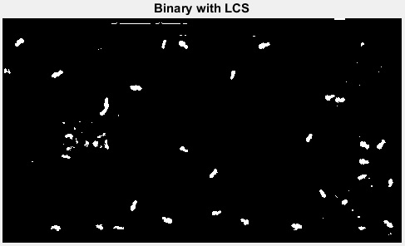

Get better Binary image?
Have to Remove Salt
Some small white pixels is not the object
Next step: create Binary image
Dilate ? Erode ?

Slide 13

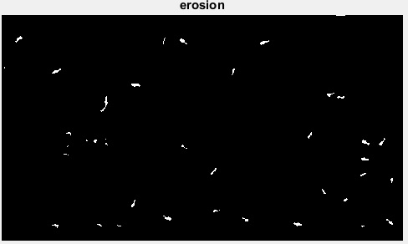
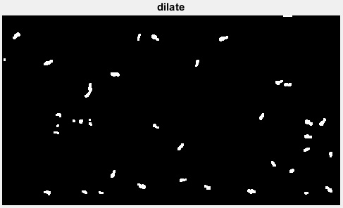
Get better Binary image?
Erode Then Dilate
Some objects combined
Lost objects

Slide 14

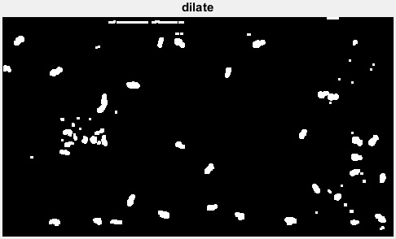
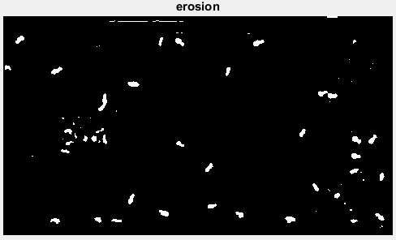
Get better Binary image?
Dilate Then Erosion
Remove noise
Keep all objects

Slide 15

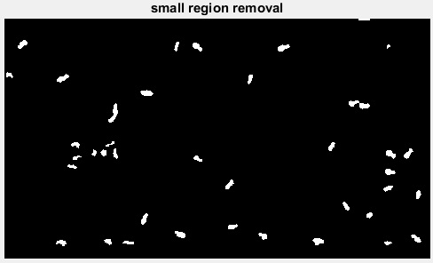
Get better Binary image?
Get a good look
binary image !
Final step:
Do CCL for getting the numbers of objects

Slide 16

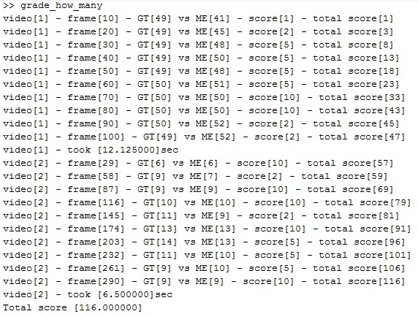
Result
Video 1:
Score 47
Time 12.125sec
Video 2:
Score 69
Time 6.5sec
Total Score 116

Slide 17

Thank you!

